Slide 1
THE WORKFORCE OF THE FUTURE
IBM Skills Academy

Slide 2
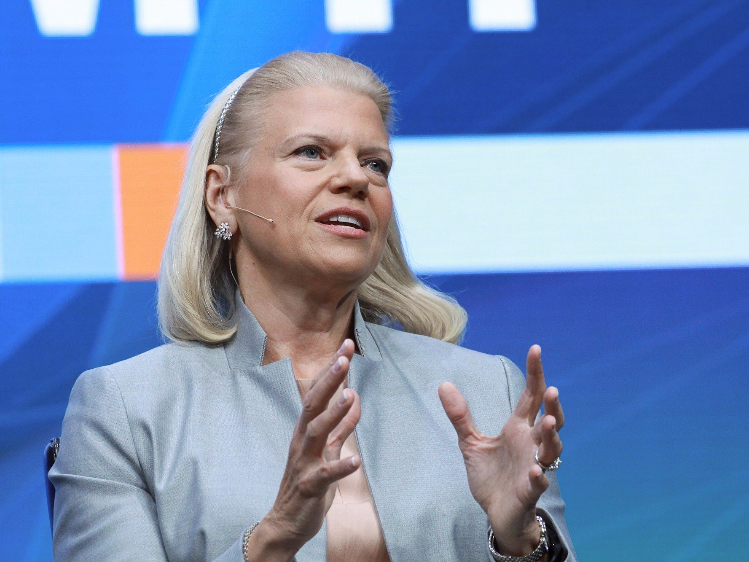
Global workforce transformation is underway
“ …number of US job openings is larger than the number of unemployed and actively looking for work…”
- Ginni Rometty 6/22/2018
By 2020 there will be
1 million
More IT job openings than applicants who can fill them
Source: U.S. Bureau of Labor Statistics
Notes:
As industries are reshaped by new technologies such as data science, cloud computing, blockchain, and artificial intelligence, the number of jobs being created is far outpacing the number of applicants.
Technology is changing so much and so fast that there are jobs being augmented by technology that the workforce is not equipped with.
As of 2016, the U.S. had roughly 3 million more STEM jobs available than it had skilled workers to fill them, according to Randstad data.
A recent study by Code.org reports that as many as 1 million programming jobs will be unfilled by 2020.
In the U.S. alone, there are more than 500,000 open jobs in technology-related sectors, according to the U.S. Department of Labor.
While some of these positions require advanced education, many do not.

Slide 3
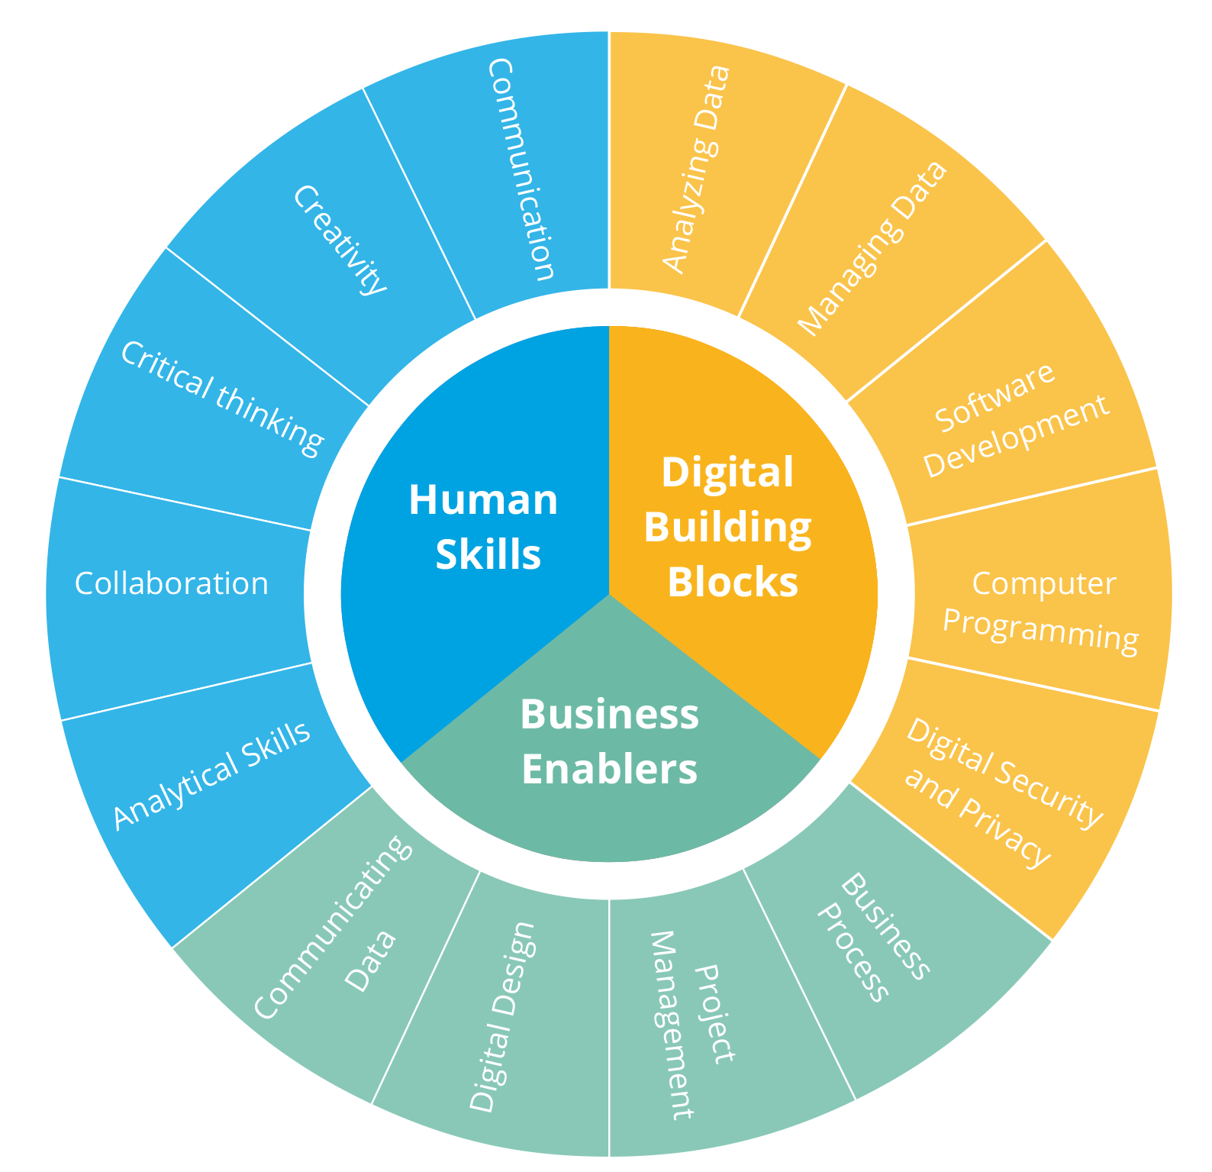
IBM SKILLS ACADEMY
A massive labor market churn is coming as part of the 4th industrial revolution
Human Skills, business skills, and digital skills.
High-speed mobile internet; artificial intelligence; widespread adoption of big data analytics; and cloud technology will predominantly impact business growth in the 2018–2022 period
By 2022, 54% of existing employees will require significant reskilling and upskilling ~ World Economic Forum
How do you know which skills are in demand that will be needed in both digitally intensive jobs, and more broadly?
Notes:
Source: https://www.ibm.com/blogs/ibm-training/do-you-need-gps-for-your-career/

Slide 4
IBM SKILLS ACADEMY
Building the future workforce
The IBM Skills Academy creates a unique capability within the university campus
Playground of new technologies
Big Ideas
New Expertise
where everyone can experiment with big ideas,
Students can acquire new expertise, and adopt an enterprise culture
Students build new enterprise grade solutions with modern and emerging technologies for immediate market impact.

Slide 5
IBM SKILLS ACADEMY
Unique Methodology to Drive Transformational Change on Campus
LECTURES
Created by IBM top experts and validated by university partners
LABS
Self-paced Hands-on labs from no-code to technology deep dives
USE CASES
Providing students a unique experience every time
INNOVATION
Leveraging our EDT Garage Method, for startup agility and enterprise scale
DRIVING VALUE

Slide 6
IBM SKILLS ACADEMY
Cybersecurity
Build instincts and expertise in security systems that understands, reasons and learns; proactively reacting to cyberthreats.
Focus Areas
Blockchain
Re-imagine fundamental business processes and invent new styles of secure digital interactions that will change the way the world works.
Artificial Intelligence
Provide cognitive capabilities to computing machines using neural-based adaptive learning techniques to enhance the human condition.
Data Science
Train systems to react on actionable insights extracted from large data sets, using advanced data science techniques and open source tools.
Internet of Things
Use end-point devices, sensors and apps to react in real-time to environmental events, providing localized solutions that integrates data and technology.
Cloud Services
Bring your ideas to life leveraging next-gen PaaS microservices that can easily be integrated into apps and sites to drive innovation in every industry.
Quantum
Leverage the principles of quantum mechanics on computers that can run new types of algorithms to solve uniquely complex problems, redefining frontier science.
Design Thinking
Solve problems using advanced concepts of agile methodology, engineering and product design, at the speed and scale of the modern digital enterprise.

Slide 7
IBM SKILLS ACADEMY
IBM Skills Academy
Digital Badges
IBM Digital Badges are reinventing how credentials are used to recognize acquired skills.
Earn Badges as you take our courses. Digital certificates are available on all the tracks.
Industry recognized digital certificates
Jointly issued by market leaders IBM and Credly
Gain access to IBM Talent Match, directly connecting IBM customers and Business Partners with verified, skilled talent.

Slide 8
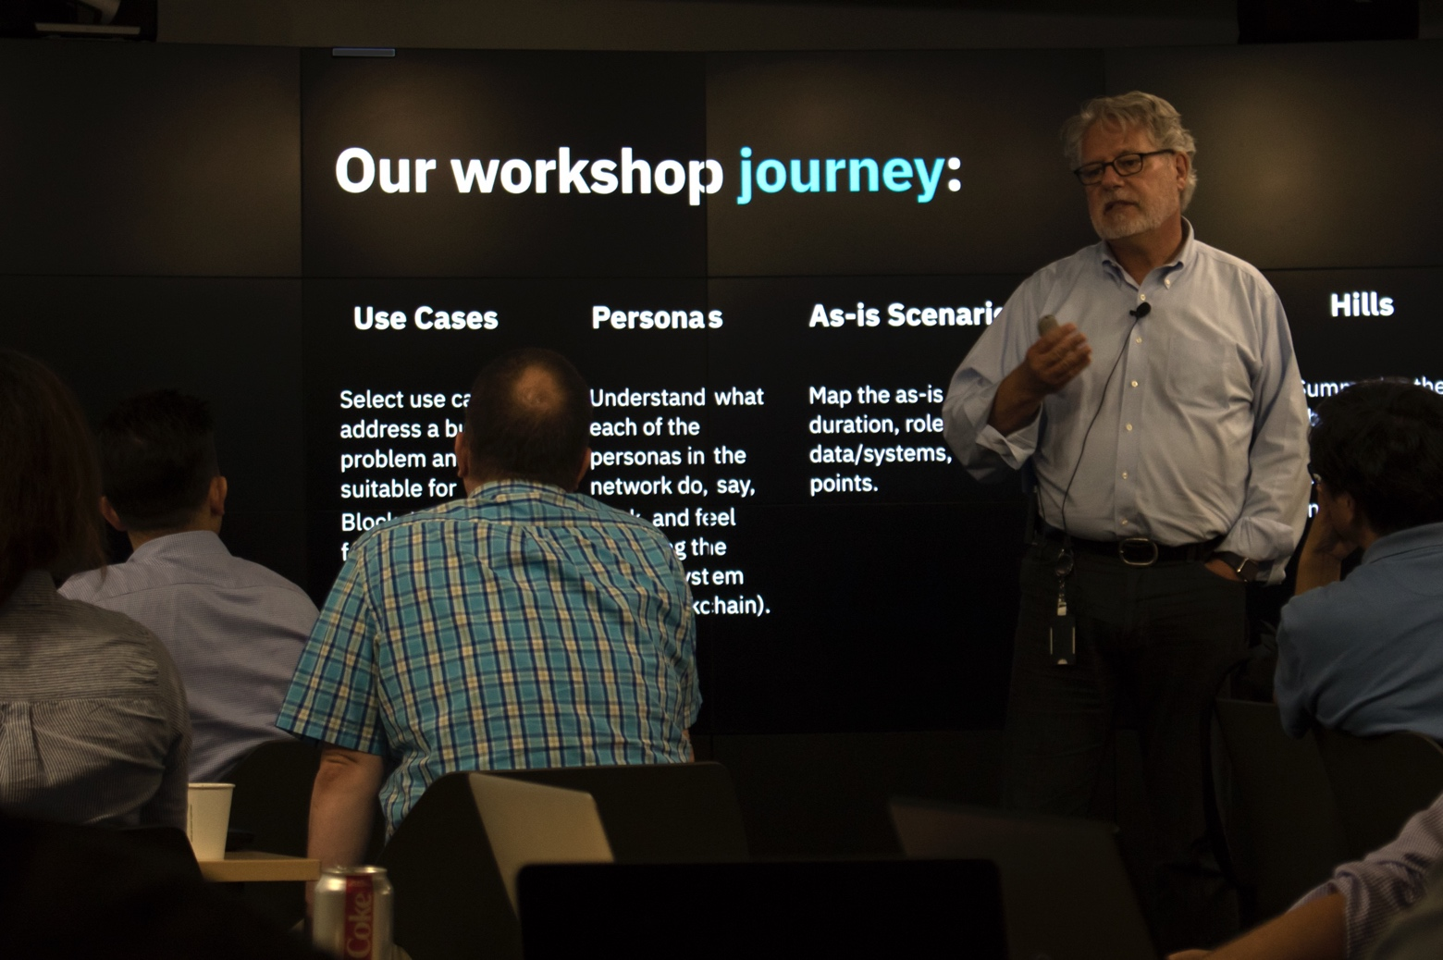
IBM SKILLS ACADEMY
IBM Skills Academy
Instructor Workshop
Industry expertise knowledge transfer
5 days intensive training
Dedicated IBM experts
Design Thinking Method
Hands-on Technical Labs

Slide 9
Adoption Lifecycle
IBM SKILLS ACADEMY

Slide 10
IBM SKILLS ACADEMY
Phase I – Setup
2.1 MOU
2.2 Client Implementation Strategy
1.1 GUP Overview
2.3 Statement of Work
3.1 Instructor Workshop Invite
1.2 IBM Skills Academy Overview and Adoption
3.2 Instructor Workshop Preparation Guide
4.1 Instructor Validation Form
1.3 Course Brief
2. Partnership Agreement
4. Delivery Preparation
University lead discussion
Track selection
Agreement sign-off
Instructor selection
Instructor intensive training
Instructor validation
Instructor badge
1. Program Exploration
3. Instructor Workshop
2.4 Course Overview
3.3 Instructor Workshop Agenda

Slide 11
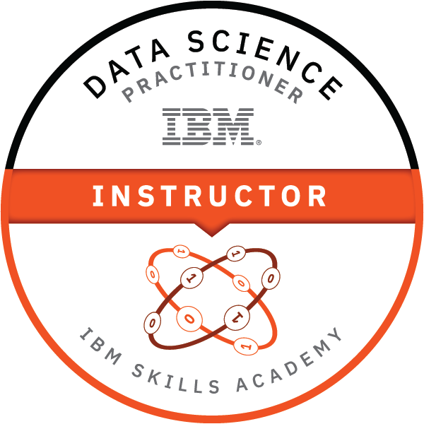
Instructor Enablement Journey
IBM SKILLS ACADEMY
1.
Complete the Design Thinking Practitioner Online Exam ^{[2]}
3.
Proof of instructor capabilities
2.
Attend the Instructors’ Workshop 2019
^{[1]} https://www.youracclaim.com/org/ibm/badge/ibm-blockchain-foundation-developer
^{[2]} https://www.youracclaim.com/org/ibm/badge/enterprise-design-thinking-practitioner

Slide 12
Instructor Badge
IBM SKILLS ACADEMY
ABOUT THIS BADGE
Through an IBM instructor-led workshop, this badge earner has acquired skills on Data Science concepts, technology, and use cases.
The badge earner has demonstrated proficiency on the following topics: Data Science Foundations, Data Gathering, Data Understanding, Data Modeling and Optimization, Design Thinking for Data Science, and Data Science Industry Use Cases.
The earner has demonstrated the capacity to deliver the Data Science course as an instructor applying pedagogical skills to drive the group work using challenged based scenarios.
SKILLS
Data Science Foundations, Data Science Methodology, Data Engineering, Data Collection, Data Cleansing, Data Wrangling, Data Visualization, Build and Train Machine Learning Models, Data Operations, Model Deployment, Model Visualization, Watson Studio, Design Thinking, Data Science Industry Use Cases, Trainer, Lecturer, Advisor, Communication, Teamwork, Problem Solving
CRITERIA
Must be a faculty member of a Higher Education Institution which has or is implementing the IBM Skills Academy Program.
Must have completed the IBM Data Science Practitioners - Instructors Workshop.
Must have earned the Enterprise Design Thinking Practitioner Badge. ^{[1]}
Must fulfill the requirements of IBM's Skills Academy teaching validation process.
https://www.youracclaim.com/org/ibm/badge/ibm-data-science-practitioner-instructor
IBM Data Science Practitioner Course
INSTRUCTOR
^{[1]} https://www.youracclaim.com/org/ibm/badge/enterprise-design-thinking-practitioner

Slide 13
IBM SKILLS ACADEMY
Phase II – Delivery
STUDENTS
Knowledge transfer of industry skills
Students access the learning material through the university education channels:
ACADEMIC COURSES
INTENSIVE BOOTCAMPS
OUTREACH PROGRAMS
UPSKILLING CORPORATE PARTNERS
6.1 Portal User Guide
5. Program Deployment
7. Student Training
IBM Branding
Marketing
Collateral
Access to learning platform
Led by university instructor
Student Validation Exam
6. Student Enrollment
8. Student Badge
5.1 IBM Skills Academy Program Brochure
8.1 Badge Issuing Form

Slide 14
Student Enablement Journey
IBM SKILLS ACADEMY
2.
Complete the Design Thinking Practitioner Online Exam ^{[2]}
3.
Proof of course completion
Multiple-choice Exam
Proof of applied skills
1.
Complete the instructor-led training.
*Instructors must have earned this course instructor’s badge
^{[1]} https://www.youracclaim.com/org/ibm/badge/ibm-blockchain-foundation-developer
^{[2]} https://www.youracclaim.com/org/ibm/badge/enterprise-design-thinking-practitioner

Slide 15
Digital Badge
IBM SKILLS ACADEMY
ABOUT THIS BADGE
Through validated Data Science instructor-led training, this badge earner has demonstrated the ability to have acquired the skills and understanding of Data Science foundational concepts and technologies.
The badge earner has demonstrated proficiency and understanding of Data Science technical topics and design thinking.
The earner has gained the ability to apply the concepts and technology of Data Science with the applicable open source tools that are relevant to real world Data Science scenarios, suitable for educational purposes.
SKILLS
Data Science Foundations, Data Science Methodology, Data Engineering, Data Collection, Data Cleansing, Data Wrangling, Data Visualization, Build and Train Machine Learning Models, Data Operations, Model Deployment, Model Visualization, Watson Studio, Design Thinking, Data Science Industry Use Cases, Collaboration, Communication, Team Work, Problem Solving
CRITERIA
Must be a student of a higher education institution attending the IBM Skills Academy Program.
Must have earned the Enterprise Design Thinking Practitioner Badge. ^{[1]}
Must pass the Data Science practitioners exam and satisfactorily complete the group exercise
IBM Data Science
Practitioner Course
https://www.youracclaim.com/org/ibm/badge/ibm-data-science-practitioner

Slide 16
Join Today !!
IBM Skills Academy
Contact us at:
ibmsaus@ibm.com
Find us here:
www.ibm.com/university

Slide 17
Trademarks and notes
© IBM Corporation 2019 IBM, the IBM logo, ibm.com, and Watson are trademarks or registered trademarks of International Business Machines Corporation in the United States, other countries, or both. If these and other IBM trademarked terms are marked on their first occurrence in this information with the appropriate symbol (® or ™), these symbols indicate U.S. registered or common law trademarks owned by IBM at the time this information was published. Such trademarks may also be registered or common law trademarks in other countries. A current list of IBM trademarks is available on the Web at “Copyright and trademark information.”
Other company, product, and service names may be trademarks or service marks of others.
References in this publication to IBM products or services do not imply that IBM intends to make them available in all countries in which IBM operates.

Slide 18
An IBM Global University Programs initiative

